Slide 1
Basic Pediatric Assessment
Amanda Allison, BSN, RN, CPN
May 2024
Reviewed: AAllison, RNC 1/2025

Slide 2
Objectives
Upon completion of this module the learner will
Demonstrate how to perform a health interview with a pediatric student.
Determine normal versus abnormal pediatric vital signs.
Utilize an appropriate pain scale for a pediatric student.
Demonstrate how to perform a focused pediatric assessment.

Slide 3
Introduction
Introduce yourself and ask for the students name
Begin to build rapport and trust
Take note of your general observations of the student
How do they look, talk, are they in distress
Across the room assessment
Do they have any medical alerts on file
Health Interview
Ask questions, listen intentfully, provide privacy

Slide 4
Vital Signs
Normal temp 98.6, exclusion at 100.0
Using our device, check temp first unless it is an emergency
RR and HR done via auscultation
BP if the school has an automatic BP cuff we can use it.
Oximeter: if the school has one, we can use it.
Normal Pediatric Vital Signs
https://www.acls-algorithms.com/wp-content/uploads/2017/03/PALS-Vital-Signs.pdf

Slide 5
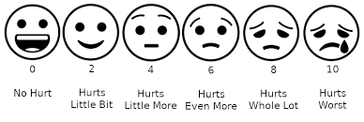
Pain
Use an age appropriate pain assessment tool
Wong-Baker FACES Pain Rating Scale is appropriate for children 3-7 years old.
0= smiling face, 10= crying face
Numeric Rating Scale, 1-10, is appropriate for children >8 years old.
0= no pain, 10= the most pain imaginable
Describe type of pain
Sharp, stabbing, aching, constant, episodic, etc

Slide 6
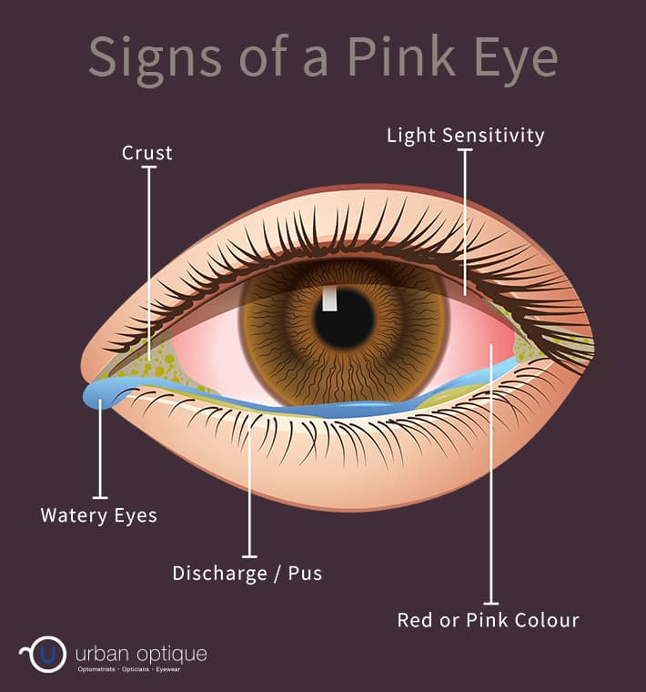
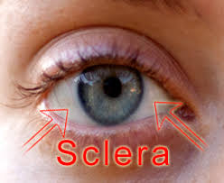
Eyes
Sclera color
PERRL
Is there any drainage
Color, consistency
Foreign object
Vision
Tracking

Slide 7
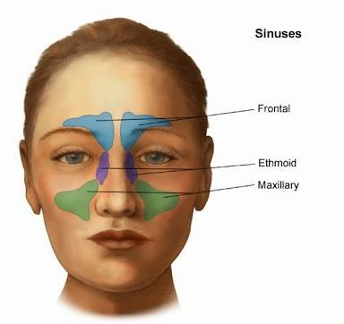
Nose
Symmetry
Have staff palpate down nose
Using otoscope you can look inside nostrils
Can they breathe through both nostrils
Can they smell
Drainage
Palpate sinuses
Direct staff member to apply pressure to assess for pain

Slide 8
Mouth
Lips
Color and moistness
Teeth and Gums
Broken, loose, rotted teeth
Red, bleeding, infected gums

Slide 9
Throat: Tonsils and Uvula: redness, swelling, exudate, pustules, drainage

Slide 10
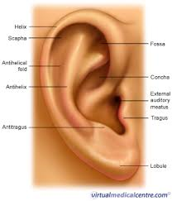
Outer Ear
Color, drainage, pain, bruising, warmth, surrounding lymph nodes.

Slide 11
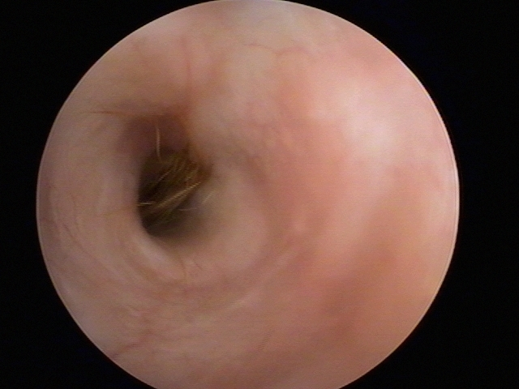
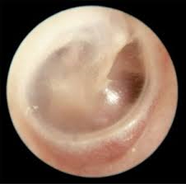
Inner Ear
Normal Findings
Canal
Vary in shape, size and color
Skin tone
Hair
Wax
Ear Drum
Pearly white/grey
Translucent

Slide 12
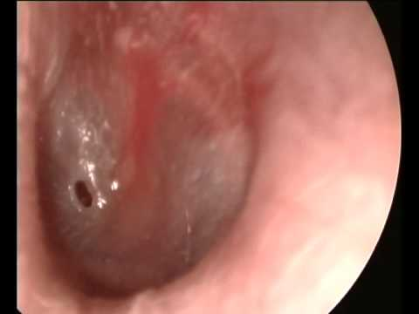
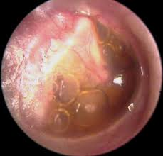
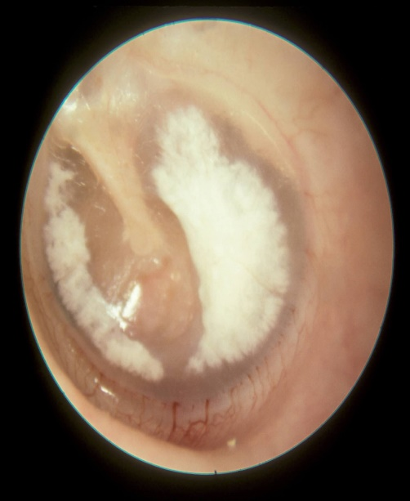
Abnormal Ear Findings
Otitis Media
Fluid
Perforation
Scarring

Slide 13
Neck
Range of motion
Pain
Shoulder shrug with resistance
Lymph node enlargement
Head movement, does it cause discomfort
Numbness or tingling anywhere

Slide 14
Cardiovascular
Heart rate
SVT in kids is 180-220
Heart sounds
https://www.youtube.com/watch?v=dBwr2GZCmQM
Color
Flushed, pale, cyanotic
Skin temperature
Cool, clammy, sweaty
Chest pain, tightness
Shortness of breath
Consider anxiety if physical findings are normal

Slide 15
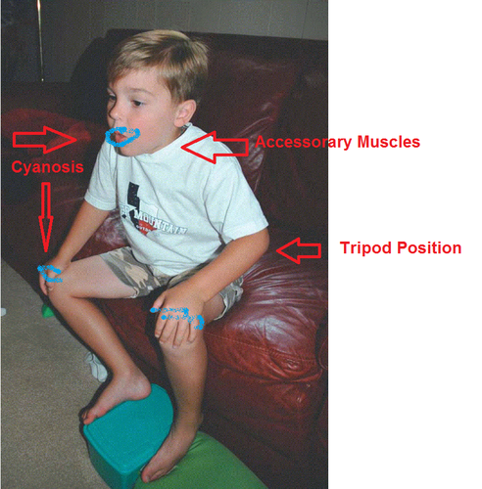
Respiratory
Respiratory rate
Respiratory effort
Nasal flaring, accessory muscle use, tri pod position
Difficulty speaking, cyanosis
Cough
Lung sounds
Front and back
Do you hear good air movement
https://www.youtube.com/watch?v=U8byn2NT_lo
Asthma
May not hear any wheezing if they are not moving air
Wheezing may only be heard after they use their inhaler and have opened up

Slide 16
Abdomen
Pain, location
Jump test
Mimics Markel’s sign
Nausea, vomiting, diarrhea
Last BM
Have they eaten, if so what
Bowel sounds
Pain with urination, lower back pain
Menses

Slide 17
Extremities
ROM
Pain
Swelling, redness or bruising
Numbness or tingling
Deformity
Strength
Hand grasp, push/pull against resistance, wall push up
CAP refill

Slide 18
References
https://www.acls-algorithms.com/wp-content/uploads/2017/03/PALS-Vital-Signs.pdf
https://www.ncbi.nlm.nih.gov/pmc/articles/PMC10378137/
https://nightingale.edu/blog/head-to-toe-assessment.html
https://www.stepwards.com/?page_id=1524

