Slide 1
Diabetic Review
For School Staff
Reviewed 1/2025 Aallison, RNC

Slide 2
Diabetes Basics
Diabetes
is a disease where the body does not produce insulin or does not use insulin properly. It is an endocrine system disorder.
Insulin
is a hormone normally made by the body. It helps glucose(sugar) enter cells where it can be used for energy.
Without insulin
glucose remains in the blood stream and cannot be used for energy by cells.

Slide 3
CGM’s
Cgm STANDS FOR CONTINUOUS GLUCOSE MONITOR
This blood Glucose (BG) monitor replaces finger pokes, most of the time
Finger pokes may still be used for confirmation in cases of high or low readings
The Cgm system consists of a sensor and transmitter that is attached to the skin and a receiver or smart device that shows and stores the readings

Slide 4
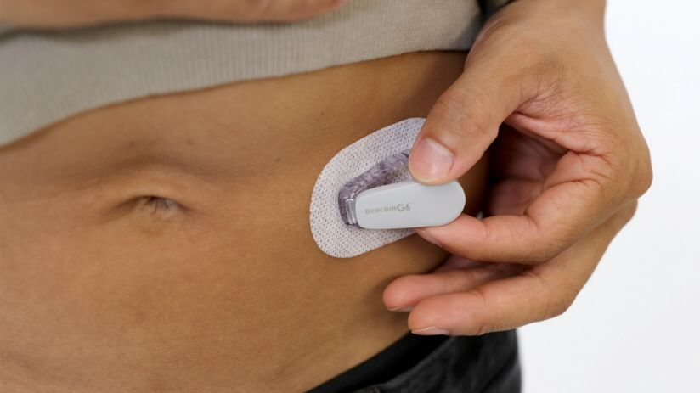
CGM System
Readings updated every 5 minutes
Trend arrows show where BG is heading
Alarms and alerts for things that need attention such as a high or low BG
Sensor is good for up to 10 days, transmitter is reusable for 90 days (until battery dies)
Sensor attaches to student, transmitter attaches to sensor

Slide 5
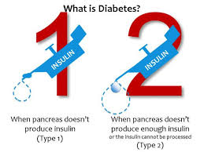
Diabetes Basics(cont.)
Two main types of Diabetes:
Notes:
Type 1 younger – Type 2 – usually older population due to increase risk factors but can be any age

Slide 6
Diabetes Basics(cont.)
Sometimes blood glucose levels are too high resulting in a condition called hyperglycemia.
If this happens, insulin must be administered to lower the blood glucose levels.
Insulin administration for children with Type 1 diabetes is essential for survival.

Slide 7
Symptoms of hyperglycemia
Dry mouth
Thirsty
Hungry
Frequent urination
Flushed
Headache
Nausea and vomiting
Sweet smelling breath
Seizures
Coma

Slide 8
Insulin
Insulin is given by injection
An injection can only be delegated to a UDA
Overseeing a child who is giving themselves insulin via insulin pump or insulin pen is a delegated task
Unopened insulin is stored in the refrigerator
Notes:
UDA – additional training

Slide 9
Diabetes Care In Schools
Emergency Care Plan/IHP: Summarizes symptoms and treatments for hypoglycemia/hyperglycemia and provides emergency contact information.
The school nurse is the most appropriate person to provide routine and emergency care when needed.
However, a school nurse is not always available, and hypoglycemia can occur at ANY time.

Slide 10
Hypoglycemia (Low Blood Glucose)
Hypoglycemia poses the most immediate risk to a student with diabetes because onset is sudden, it is not always preventable, and may progress to unconsciousness and convulsions if left untreated.

Slide 11
Symptoms of hypoglycemia
Hunger
Fatigue
Shakiness
Weakness
Rapid pulse
Confusion
Cold clammy skin
Seizures
Loss of consciousness

Slide 12
Hypoglycemia(cont.) (Low Blood Glucose)
Hypoglycemia – Possible causes:
Too much insulin
Too little food or delayed meal/snack
Extra physical activity
Illness
Medications
May occur for no apparent reason

Slide 13
Mild And Moderate Hypoglycemia
When mild or moderate symptoms occur, immediate treatment is required to prevent progression to severe hypoglycemia:
Treat at onset of symptoms by having student eat or drink fast acting carbohydrates(if able to swallow)
NEVER leave the student unattended

Slide 14
Severe Hypoglycemia
If a student exhibits unconsciousness or unresponsiveness, seizures(convulsions), or is unable to swallow, this is an EMERGENCY:
Administer glucagon as prescribed
Call 911
Contact school nurse
Contact parent
Treat on the spot and NEVER leave the student unattended
Emergency medication

Slide 15
Glucagon for hypoglycemia
https://www.google.com/search?q=glucagon+use+video&rlz=1C1GCEU_enUS968US969&oq=glucagon+use+video&aqs=chrome..69i57.4728j0j7&sourceid=chrome&ie=UTF#fpstate=ive&kpvalbx=_Ue0xY4bnEPLdptQPvtyFmAw_21&vld=cid:bcb9e974,vid:cHuyxbYG26g,st:59

Slide 16
Gvoke for hypoglycemia
https://youtu.be/9RxvgQjFwl4
Cannot be injected through clothing.

Slide 17
Baqsimi for hypoglycemia
https://www.baqsimi.com/how-to-use-baqsimi

Slide 18
Next Steps
Remain with the student until emergency medical services assumes control.
The student should not resume normal activities.
Notify appropriate parties of the incident.
NASN (2021)

Slide 19
Don’t Be Surprised If…
The student does not remember being unconscious or is incoherent or lethargic.
The student feels nauseated, vomits or has a headache.

Slide 20
Quick Review!
Mild to moderate hypoglycemia can be treated with a quick acting source of carbohydrate (15 grams).
Signs of severe hypoglycemia include:
Unconsciousness
Seizures
Inability to swallow

Slide 21
Quick Review!(cont.)
Severe hypoglycemia is a medical emergency.
Administer the glucagon
Call 911
Treat, then follow the Emergency Action Plan.

Slide 22
Oral Hypoglycemia Agents
Oral hypoglycemia agents are used to treat Type II diabetes and sometimes are added to treatment of Type I diabetes.
Give 30 minutes before a meal.
Skip the dose if a meal is skipped.

Slide 23
References
Anderson, K. (2023) Mosby’s textbook for medication assistants, 2nd Ed. Elsevier Inc.
Glucagon Emergency Kit (2022). https://glucagonemergencykit.com/index.php/glucagon-emergency-kit/
Khan, F. (2022). How to store an Epipen. Wikihow. https://www.wikihow.com/Store-an-EpiPen
National Association of School Nurses (October 2021). Medication Administration: Delegation Checklist. Medication Administration Toolkit. www.nasn.org
National Association of School Nurses (October 2021). Model policy: Administering medications to students. Medication Administration Toolkit. www.nasn.org
National Association of School Nurses (October 2021). Model policy: Administering emergency medications to students. Medication Administration Toolkit. www.nasn.org
National Association of School Nurses (2021). School nursing evidence-based clinical practice guidelines: Medication administration in schools. www.nasn.org (2021)

