Slide 1
Tri-County Staff Inservice
AAllison, RNC 1/2025

Slide 2
Review
Anaphylaxis
Asthma
Concussions
Seizures
Diabetes
AED
Basic First Aid
Emergency Preparedness

Slide 3

Anaphylaxis
Anaphylaxis (anaphylactic reaction) is a severe, life-threatening sensitivity to an antigen (unwanted substance).
A medical emergency, signs and symptoms can occur within seconds:
  Sweating
  Shortness of breath
  Low blood pressure
  Irregular pulse
  Respiratory congestion
  Swelling of the larynx (laryngeal edema), lips, face and neck
  Hoarseness
  Dyspnea

Slide 4

Triggers
Bee stings
Food allergies
  Peanuts
  Tree Nuts
  Eggs
  Wheat
  Soy
  Many, many more

Slide 5
Epinephrine
It quickly constricts blood vessels, raising blood pressure
It relaxes smooth muscles in the lungs to improve breathing
It stimulates the heart to beat
Will cause the heart rate to increase
It works to reverse the hives and swelling around the face and lips

Slide 6

When To Give The EpiPen…
Based on student’s symptoms:
Hives spreading over the body
Wheezing, difficulty breathing or swallowing
Swelling in the face, neck, tongue or tingling in the tongue
Vomiting
Signs of shock such as extreme paleness/gray color, clammy skin, loss of consciousness
Any other child specific known symptom
Administer EpiPen
Call 911!
Epinephrine buys you time….
Epinephrine SAVES LIVES!

Slide 7
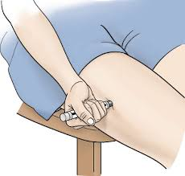

Where Do I Give The EpiPen?
The EpiPen is administered ONLY into the large outer thigh muscles
Can be given through clothing
Give at a 90 degree angle (both sizes)

Slide 8
Video
https://www.youtube.com/watch?v=Ig9rWYYBW8Y

Slide 9
What Is Asthma?
Asthma is a chronic inflammatory lung disease occurring in both children and adults
Physiology: During an asthma episode, the lining of the airways become:
  Swollen, inflamed and more irritable
  There is constriction of the muscles around the airways
  Increased amounts of mucous may be produced leading to even further air obstruction in the airway

Slide 10
Common Asthma Triggers
Exercise
Weather – cold air, changes in temperature or humidity
Irritants – cigarette smoke, wood smoke, strong odors, pollution
Allergens/infections
Medicines/chemicals
Coughing/yelling/laughing
Acute stress
Plants
Animal dander
Perfumes and deodorizers

Slide 11
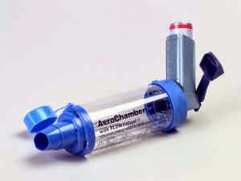
Symptoms Of Asthma
Restlessness
Irritability
Cough
Wheezing
Shortness of breath
Tightness in the chest
Retractions
Speaking in phrases/words instead of sentences
Treatment of asthma includes use of an inhaler. We prefer for students to use a spacer as well, if possible.

Slide 12

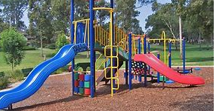

Head Bumps

Slide 13
Seizures
What is a Seizure?
A neurological condition, usually chronic
Abnormal, excessive electrical discharges from the neurons in the cerebral cortex which may cause loss of consciousness and violent and sudden contractions
Seizures can also be called convulsions
Causes
  Fever, head injury, poisoning, genetic condition

Slide 14
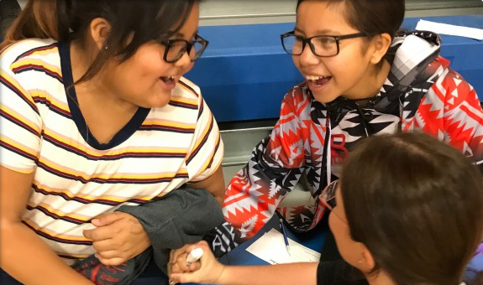
Seizure First Aid
Notify office immediately, call eSchool Nurse
Stay calm and track time and type of seizure, what body parts are involved
Keep student safe
  Lower to floor if needed
  Place soft item under head if needed
  Keep airway open and monitor breathing
Do not attempt to restrain or hold them still
Do not put anything in mouth
  Other than Dr. ordered emergency medication

Slide 15
Seizure First Aid: After Care
Turn on their side when seizure stops
    They may vomit, this will help prevent choking
Stay with student and continually monitor
  Breathing, level of consciousness, additional seizure activity, any injury that may have occurred
Give emergency medication as directed, if needed
  eSchool nurse will help direct this care and administration
Call 911 as needed
  eSchool nurse will help determine if and when this may be needed
Inform parent of all seizures

Slide 16
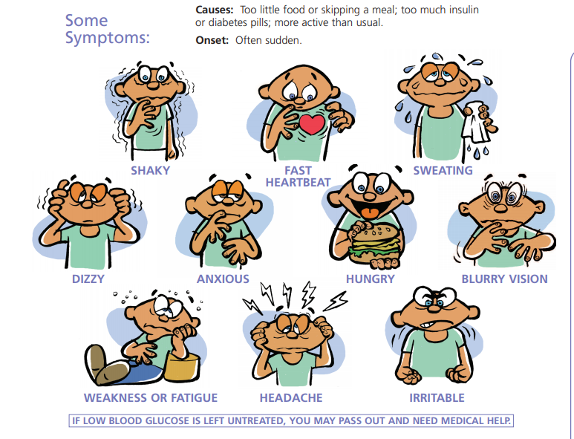
Low Blood Sugar
Check BS
Follow plan
Notify office
Provide juice, snacks

Slide 17
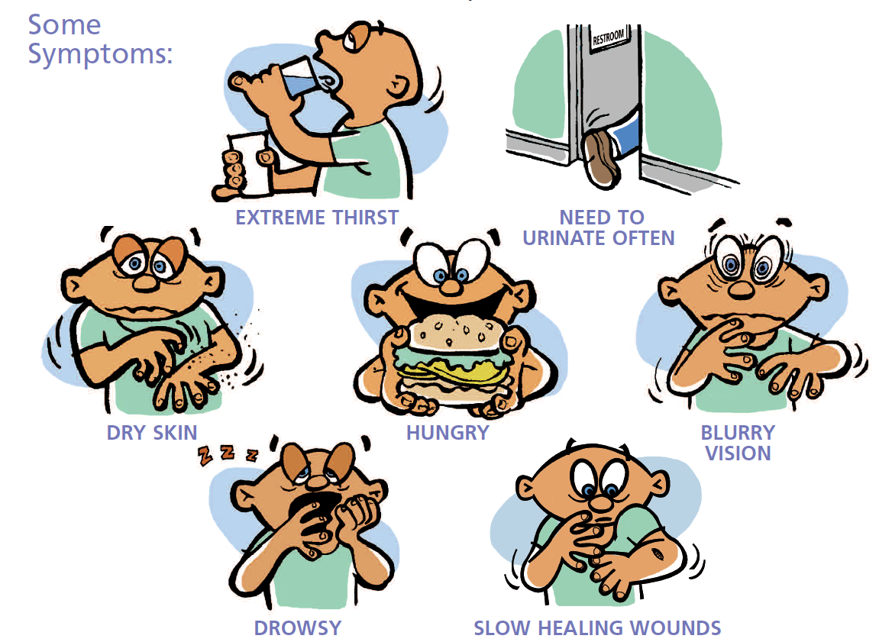
High Blood Sugar
Take to the office if it is a known diabetic
If you notice symptoms in an undiagnosed student notify the nurse or parent

Slide 18
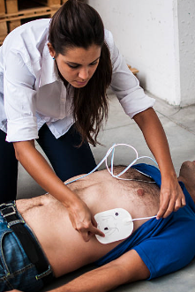
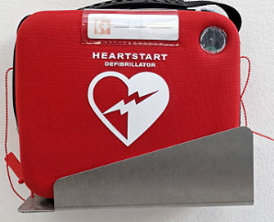
AED (Automatic External Defibrillator)
Video:
https://www.youtube.com/watch?v=BAWGjNAj_vA
911
Where is it kept
Pad placement
Some are fully automatic

Slide 19
Bleeding
Protect yourself, always wear gloves!
Bleeding
  Most bleeding can be controlled with first aid.
  Apply direct pressure using gauze or a cloth (towel, blanket, clothing), elevate if able.
  Do not remove the cloth if it becomes soaked, get an additional one and add layers.
When to call 911:
  If the bleeding is arterial, bright red and spurting out.
  Bleeding is soaking through bandages.

Slide 20
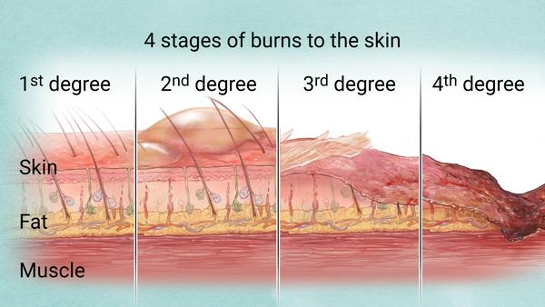
Burns
Burns
  Stop the burning process.
  Cool with water, do not use ice.
  Cover with dressing, do not apply vaseline or other ointment unless directed to by a trained medical professional.
  Do not break any blisters.
When to call 911
  Burns cover a large part of the body
  Areas of the skin are white or black
  Burns to the face/neck with any sign of difficulty breathing

Slide 21
Fractures
Fractures
  Do not try to straighten the bone.
  Use a splint or something firm and flat to stabilize the extremity, elevate if able.
    Clipboard, piece of wood, hard cover book.
  Apply a cool pack.
When to call 911
  Do not move them if you suspect a fracture to the spine/back, neck, pelvis or thigh.
  If it is an open fracture, the bone has broken through the skin.
  If the skin around/below the fractue is cold, clammy or looks blue/grey.

Slide 22
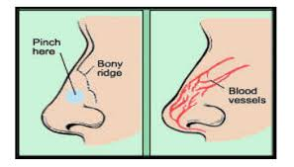
Nosebleeds
Nosebleeds
  Lean forward
  Pinch just below the bridge for a full 5 minutes and repeat as needed until bleeding stops.
  Apply cool pack to back of neck or bridge of nose.
  Apply a layer of vaseline to inner nostril.
When to call 911
  If bleeding does not stop and student begins to have any difficulty breathing or remaining awake.

Slide 23
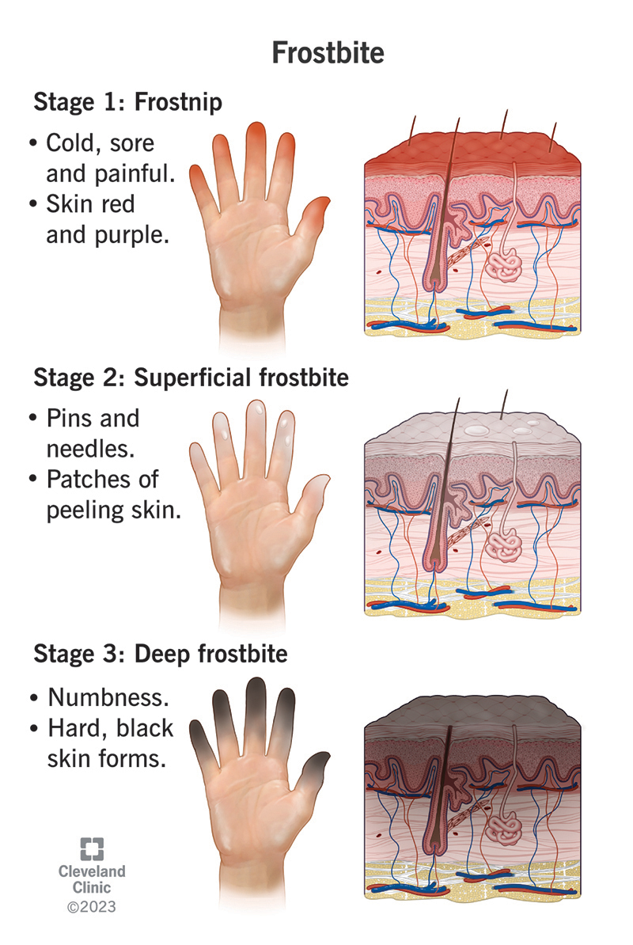
Frostbite
Frostbite
  Submerge in warm water for 20-30 minutes.
  Do not rub the area or use a heat source, heating pad.
Medical Treatement Needed if:
  If skin is hard or white, waxy appearing.
  Blisters form.

Slide 24
Emergency Preparedness
Go Kit in othe office
  Students with ER plans and meds stored seperatly so they can be grabbed quickly.
  Bag stocked with basic supplies such as:
    Gloves, assorted bandages, one use cold packs, tape, gauze pads/rolls, scissors, antibiotic ointment.
Classroom Considerations
  First Aid kit
    Gloves, Various Band-Aids, gauze pads, tape, flashlight, whistle, toilet paper.
  Snacks/water
      Diabetic student
  Bucket method
    Store items that may be needed during a lockdown, use for a bathroom.

Slide 25
Questions/Scenarios
What questions do you have?
Are there any scenarios you have thought of and want to talk through ideas of what you would need to do?
Group discussion on any ideas or things you would like to implement?

Slide 26
References
Anderson, K. (2023) Mosby’s textbook for medication assistants, 2nd Ed. Elsevier Inc.
Glucagon Emergency Kit (2022). https://glucagonemergencykit.com/index.php/glucagon-emergency-kit/
Khan, F. (2022). How to store an Epipen. Wikihow. https://www.wikihow.com/Store-an-EpiPen
National Association of School Nurses (October 2021). Medication Administration: Delegation Checklist. Medication Administration Toolkit. www.nasn.org
National Association of School Nurses (October 2021). Model policy: Administering medications to students. Medication Administration Toolkit. www.nasn.org
National Association of School Nurses (October 2021). Model policy: Administering emergency medications to students. Medication Administration Toolkit. www.nasn.org
National Association of School Nurses (2021). School nursing evidence-based clinical practice guidelines: Medication administration in schools. www.nasn.org (2021)
Very Well Heath: https://www.verywellhealth.com/basic-first-aid-procedures-1298578

