Slide 1
Ear Exam
Amanda Allison, RNC
1/2025

Slide 2
Why
Part of head-to-toe assessment
Screen for illness or investigate ear symptoms
URI, fever, pain, drainage, hearing changes
What you could find….
Wax build up
Infection
Foreign body
Swelling
Ruptured ear drum
Fluid
Scarring

Slide 3
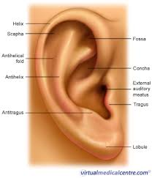
External Exam
Color, drainage, pain, bruising, warmth and surrounding lymph nodes.
Notes:
Inspect and feel the external ear.
Color, drainage, pain, bruising, warmth
Also palpate surrounding lymphnodes

Slide 4
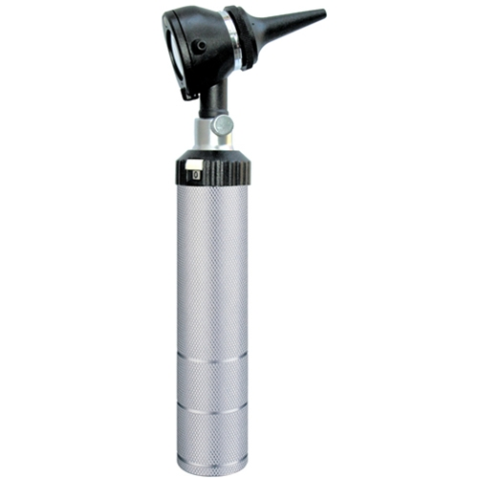
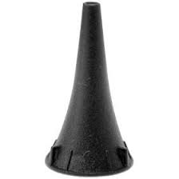
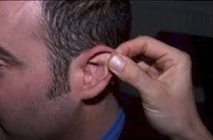
Internal exam
Prepare your patient
Sitting, head tilted slightly
Prepare your equipment
Otoscope
Cover: adults 4-5mm
Up and back

Slide 5
Visualize angel of canal
Insert Otoscope
Point slightly downward and towards nose

Slide 6
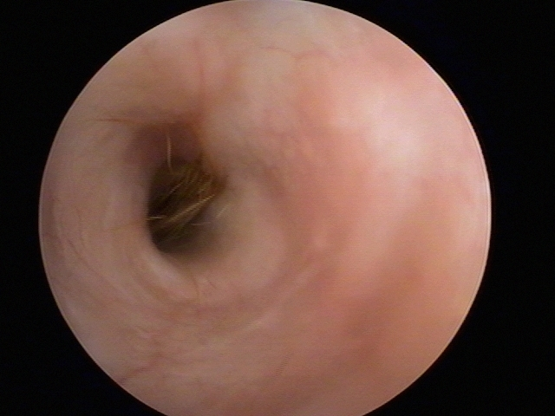
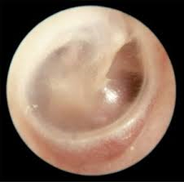
Normal Findings
Canal
Vary in shape, size and color
Skin tone
Hair
Wax
Ear drum
Pearly white/grey
Translucent

Slide 7
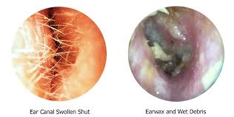
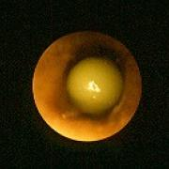
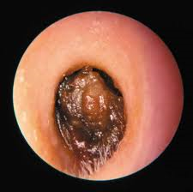
Abnormal Canal
Other things could include~
Pus, blood, scabs

Slide 8
Otitis media

Slide 9
Fluid behind ear

Slide 10
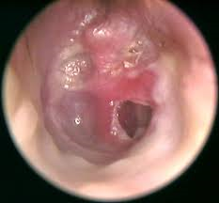
Perforation

Slide 11
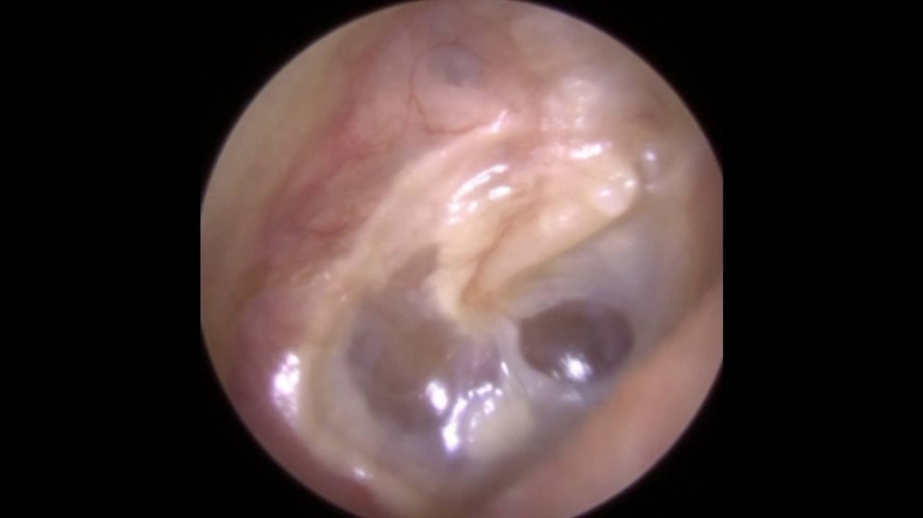
Scarring

Slide 12
Bulging

Slide 13
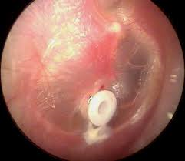
Tubes

Slide 14
Tube fell out

Slide 15
Thank You
Your time is greatly appreciated.
© Property of Avel eCare

