Slide 1

Tube Feeding with Gtube and Infinity Pump
Amanda Allison, RNC
1/2025

Slide 2
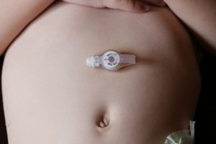
G-Tubes
A G-tube (GT), also referred to as a mic-key or a button, is the most common type of feeding tube.
It is surgically placed through the wall of the abdomen into the stomach and is used to deliver nutrition and medications.

Slide 3
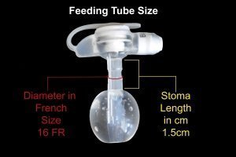
Parts of the GT
B: When safety plug is open, this is where the extension tubing attaches to the GT.
A: Safety Plug: must open prior to feeding and snap closed when finished.
B
A
C
C: Port used to attach a syringe to fill the balloon with. NEVER instill any feeding or medication into this port.
Above Skin
Under Skin
D
D: Balloon that is inflated with sterile water to keep GT in place. The balloon lies beneath the skin.

Slide 4
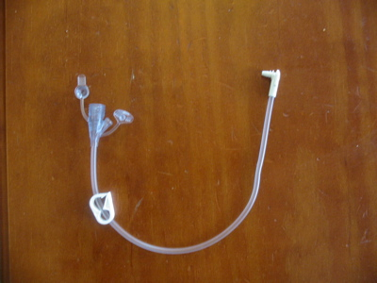
Attaching the extension set
https://www.youtube.com/watch?v=2krLo9ufVhY

Slide 5
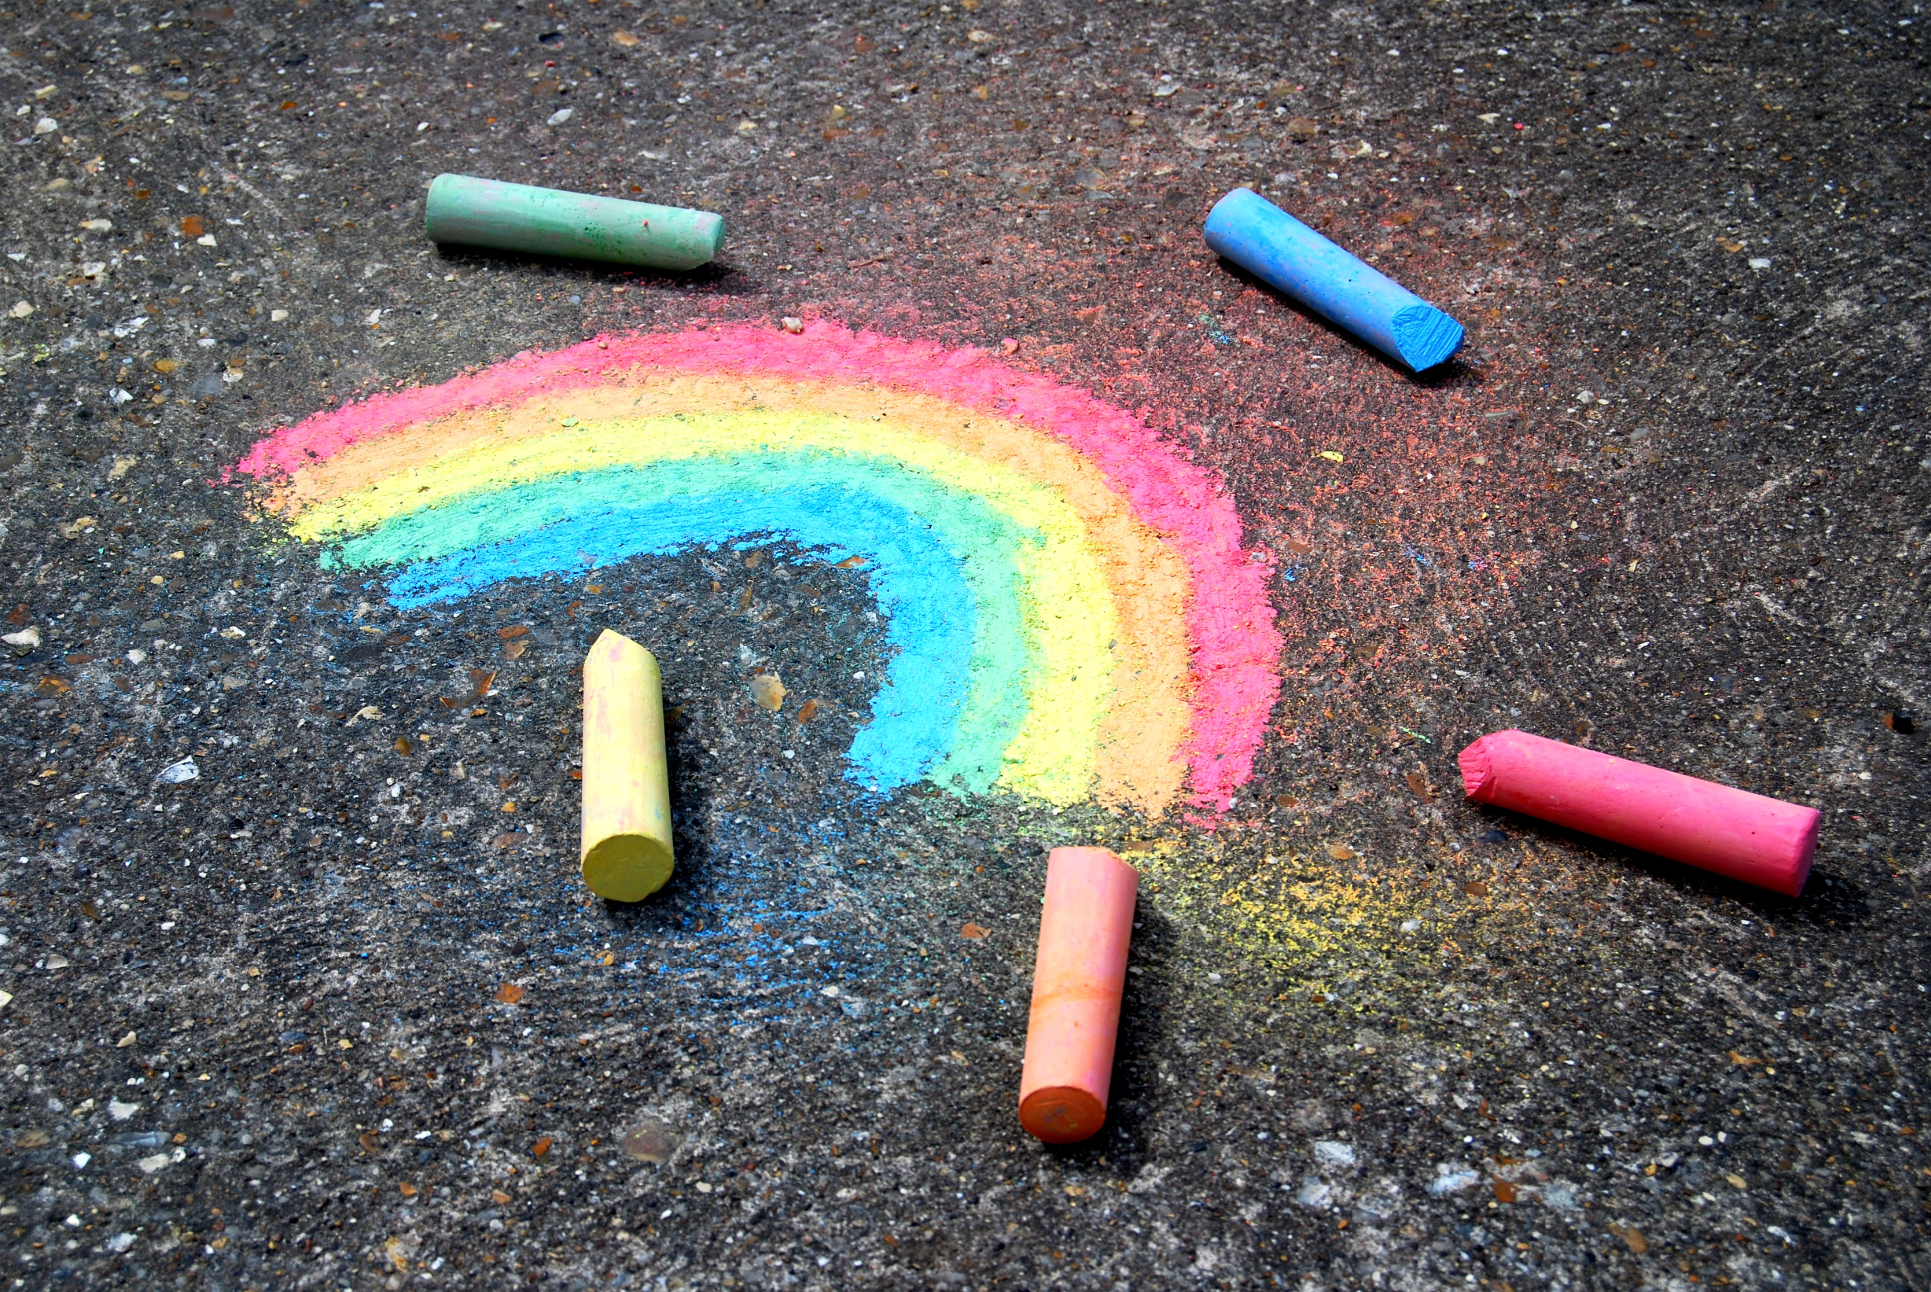
Steps to Complete a Feeding
Wash hands
Gather all supplies from backpack
  Extension tubing, feeding bag and tubing set, pump, Pediasure formula
Position child for feeding, sitting upright in chair, at least 30 degrees head elevation.
Wash hands and put on clean gloves
Prepare feeding
  Connect feeding bag tubing and extension tubing.
  Pour one can of Pediasure into feeding bag
  Close bag by securing cap
  To remove extra air in bag, turn bag upside down to prime tubing
  Prime tubing by gently pushing button below the drop symbol while gently squeezing bag. This will allow air, and then formula to flow through tubing.
  Place into backpack

Slide 6
Start and End of Feeding
Start feeding
  Open door and position tubing around wheel, stretching lightly. Seat cassette into pump and close door.
  Push On/Off key to turn pump on
  Set rate if needed by pressing + or – key to increase or decrease. Rate needs to be 480 mL/hr.
  Press Rate/Dose key and set dose with + or – key as needed. Dose is 240 mL.
  Attach extension tubing to G-tube button
    Open safety plug on button and attach extension tubing, twist to lock in place.
  Push Run/Pause to run feeding.
  When finished push On/Off to turn pump off
  Administer 50 mL water bolus after feeding
  Remove gloves and wash hands
End feeding
  Wash hands and put on gloves
  Disconnect button extension tubing from button
    Twist to unlock and disconnect
    Close safety plug on button
Remove tubing from pump and rinse all tubing and bag well with warm water, student gets one bag per day for feedings so it must be cleaned in between.
Remove gloves and wash hands
Place supplies back into backpack
Document as needed
Monitor for feeding tolerance

Slide 7
Signs of Feeding Intolerance
During and after feeding monitor for signs of intolerance such as~
Pain
Nausea
Vomiting
Bloating
Excessive gas
If these occur stop feeding and notify eNurse
If GT becomes dislodged or comes out cover area with a clean gauze pad and call dad immediately. He will need to come to school to attempt to replace GT and if not able student will need medical attention.

Slide 8
References
Infinity Enteral Feeding Pump MOOG website. Retrieved from https://infinityfeedingpump.com/
Feeding Tube Awareness Foundation website. Retrieved from https://www.feedingtubeawareness.org/g-tube/
Any Questions?

Slide 9
Thank You
Your time is greatly appreciated.
© Property of Avel eCare

